Slide 1
Spectroscopic factors from experiment … and what are they good for Alexandra Gade
Monday
Tuesday
Introduction – spectroscopic factors from reactions
Transfer with Si arrays, HELIOS, γ-ray tagged
Complementary: Knockout
Messy: How to consolidate it all … or not?
Appendix: Tricks: exploit selectivity
Thursday

Slide 2
Outline
Introduction: What is a spectroscopic factor and why should you care about the concept behind? Now: experimenters view; subsequent lecture: theory
Modern experiments: Recent examples – Physics background and experimental approach
Si array – ¹³²Sn
Novel scheme: HELIOS – ¹³⁶Xe
Gamma-tagged with spectrograph – Astro
At the luminosity frontier: Knockout – ³⁴Si
Appendix: Selectivity – HI induced

Slide 3
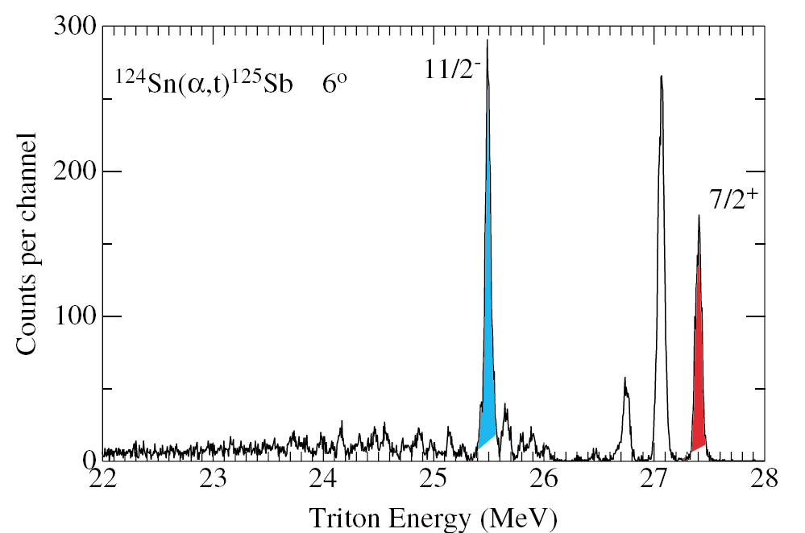
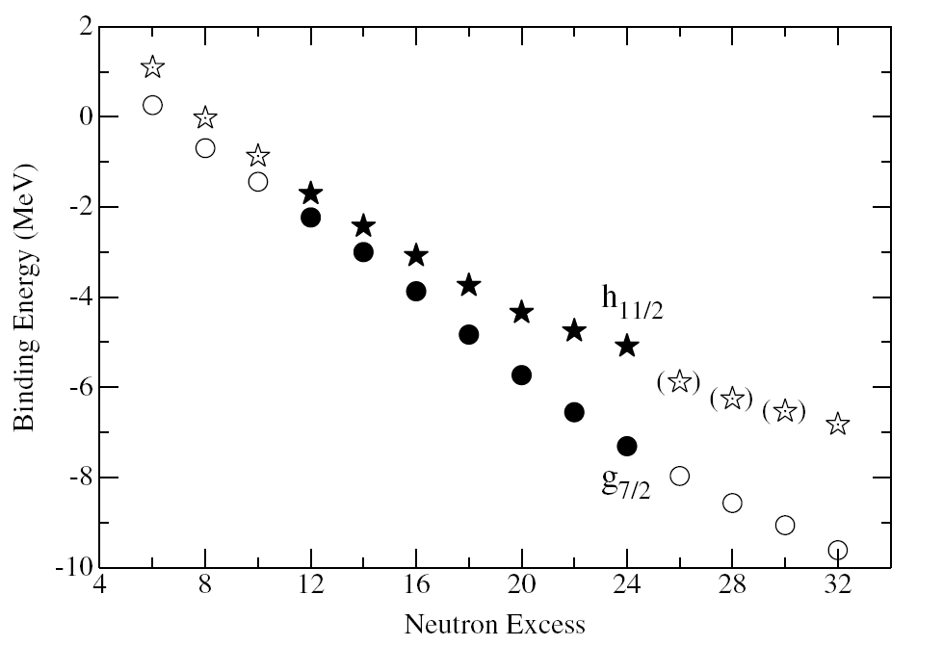
Spectroscopic factors
Question
How “single-particle-like” is a certain state in a nucleus?
Or …
Assume you populated an 11/2⁻ and 7/2⁺ state in ¹²⁵Sb, when does it make sense to associate these two states with the πh_{11/2} and πg_{7/2} single-particle orbitals?
J.P. Schiffer et al., PRL 92, 162501 (2004)

Slide 4
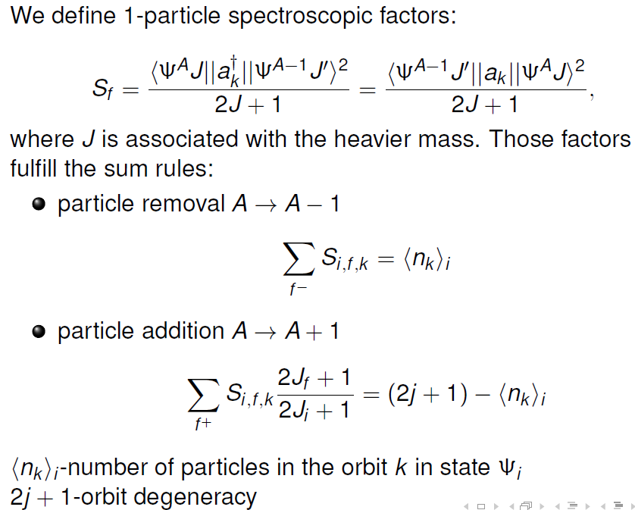
For this, define the spectroscopic factor S as follows
What is the “probability” that the A-nucleon system Ψ(A) looks like the Ψ(A-1) system + 1 nucleon in orbital k
Or
What is the “probability” that the A-1-nucleon system Ψ(A-1) looks like the Ψ(A) system with 1 nucleon removed from orbital k
1.
2.
Figure from M. Huyse

Slide 5
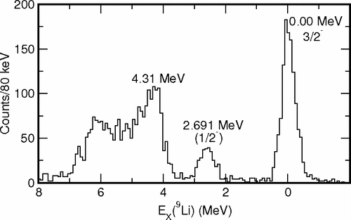
How can we probe this in an experiment …
Perform experiments that do exact that: adding or removing a nucleon without messing with the Ψ(A-1) or Ψ(A) system, respectively, …. and how for short-lived, rare isotopes?
→ Knockout and transfer reactions … in reverse kinematics (the nucleus of interest is the beam)
Example: Neutron-adding transfer reaction - d(⁸Li,p)⁹Li
One-nucleon knockout reaction: a nucleon is removed from a fast moving projectile
Figure from M. Huyse
A. H. Wuosmaa et al., PRL 94, 082502 (2005)

Slide 6
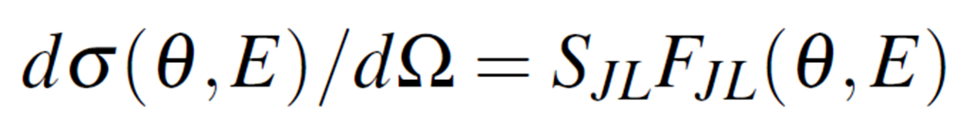
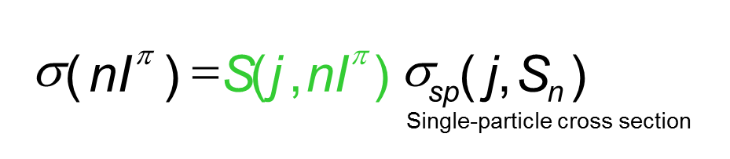
Important – read carefully, and then again … and think about it
The observable in such experiments is the CROSS SECTION for the population of final states, while SPECTROSCOPIC FACTORS are extracted within a theoretical scheme that involves nuclear structure models and reaction dynamics (can be messy)
Independent of being an observable or not, the concept of spectroscopic factors is extremely useful and at the heart of data interpretation within configuration-interaction models
Be aware of extreme reaction model dependencies and only compare spectroscopic factors extracted within the same theoretical framework
Transfer:
DWBA form factor, optical models enter, …
What we measure
Knockout:
Figure from M.
from eikonal theory

Slide 7
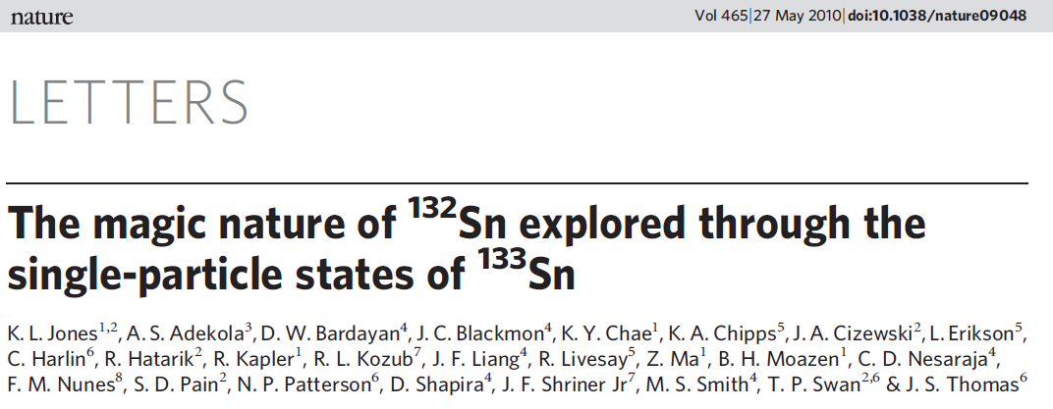
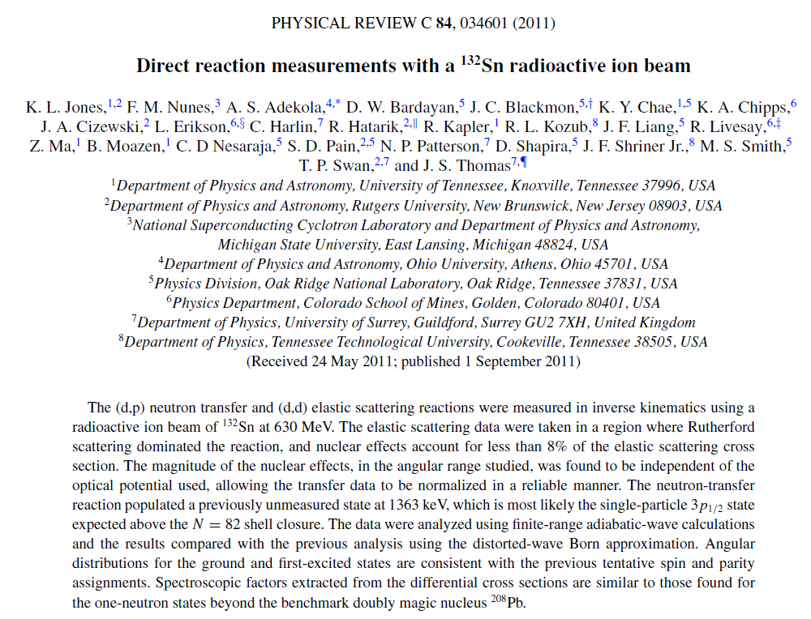
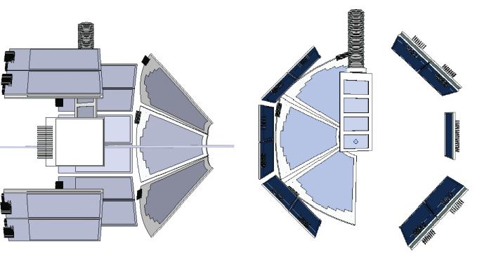
Transfer reactions with Si arrays – single-particle structure around ¹³²Sn
Figure from M. Huyse

Slide 8
Transfer reactions with Si arrays – single-particle structure around ¹³²Sn
Single-particle information outside of neutron-rich doubly-magic nuclei is essential to benchmark theoretical models that dare to extrapolate from there
¹³²Sn is a heavy, neutron-rich nucleus with presumably closed proton and neutron shells at Z=50 and N=82.
Strategy: Perform neutron-adding transfer reaction, (d,p), on radioactive ¹³²Sn beam
¹³²Sn radioactive beam at 630 MeV was provided at the HRIBF ISOL facility at ORNL . The proton freed in the (d,p) reaction was detected with the ORRUBA Si array
Figure from M. Huyse

Slide 9
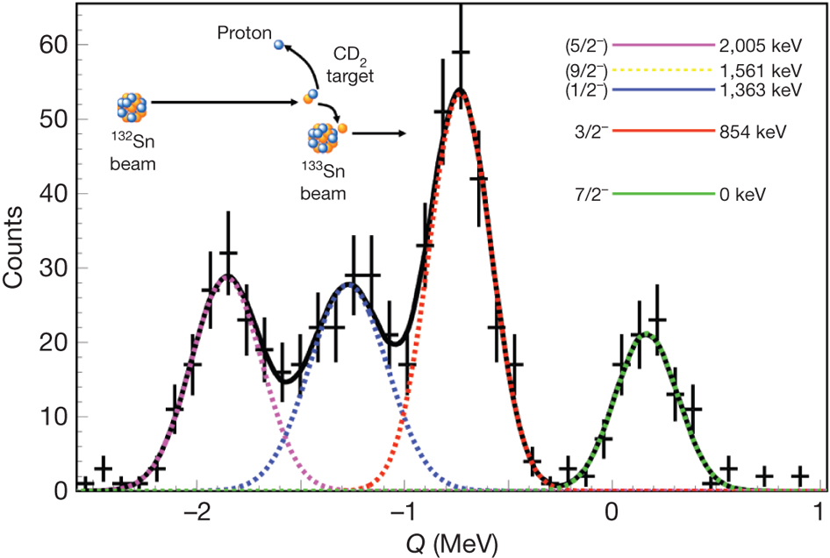
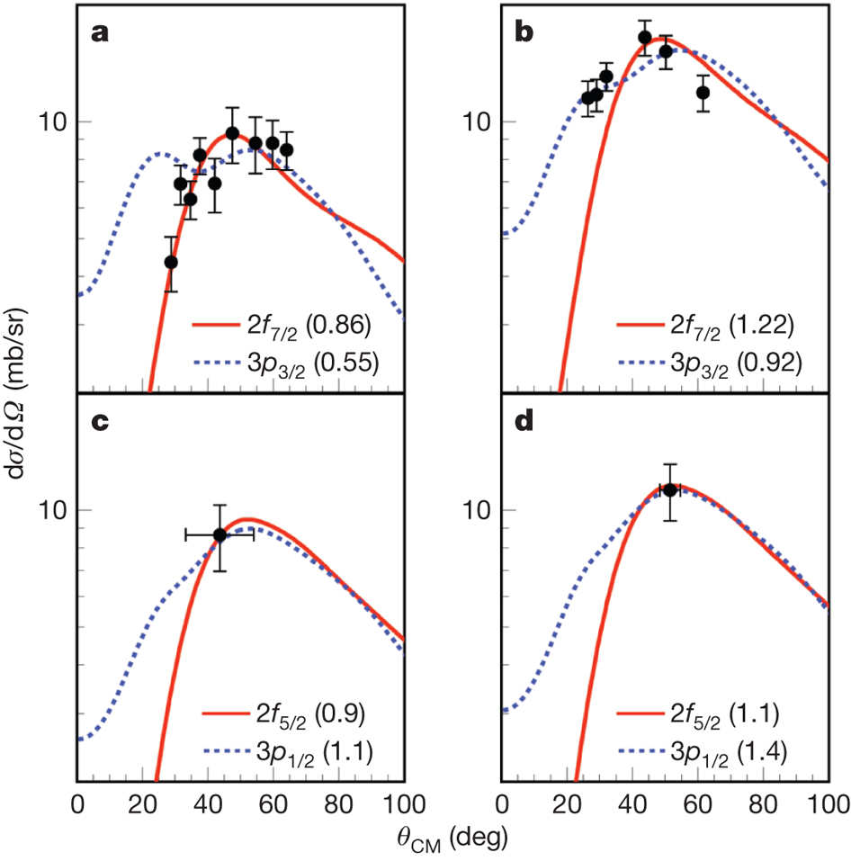
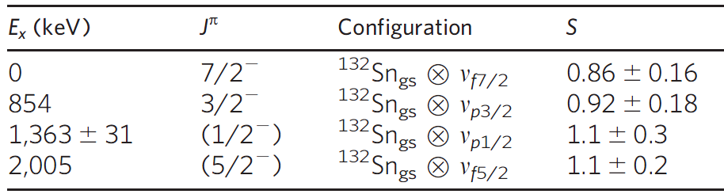
(d,p) reaction in inverse kinematics on ¹³²Sn beam (at HRIBF at ORNL)
Shape of proton angular distribution depends on the transferred orbital angular momentum
Q value spectrum from the detected proton energy
Spectroscopic factors extracted from cross sections in comparison to DWBA
Single-neutron structure around doubly-magic ¹³²Sn!
K. L. Jones et al., Nature 465, 454 (2010)

Slide 10
Experimental considerations
For interesting cases, typically low rare-isotope beam intensity – tricky to get enough points for angular distributions, also kinematics of the light particle may not be favorable
Modest resolution if light-ion-tagged, mandates thin targets and thus requires higher beam rates (10⁴ – 10⁶ pps)
K. L. Jones et al., Nature 465, 454 (2010)

Slide 11
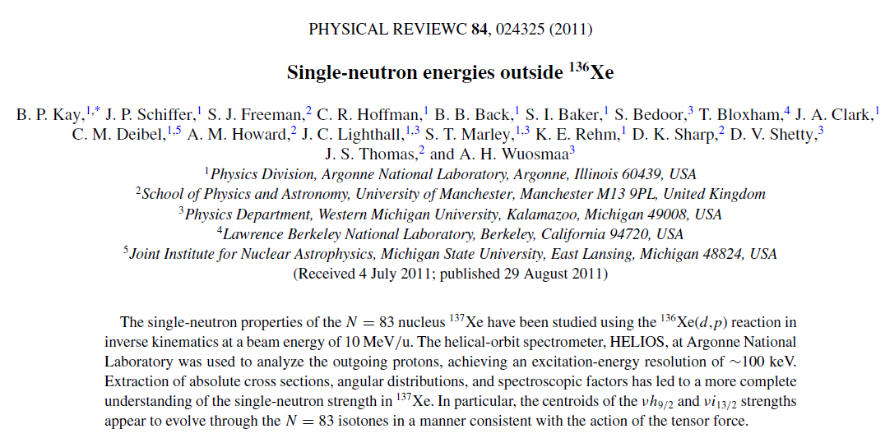
Transfer reactions with HELIOS – single-particle neutron energies outside of ¹³⁶Xe
Figure from M. Huyse

Slide 12
Transfer reactions with HELIOS – single-neutron energies outside of ¹³⁶Xe
Shell structure is known to change in nuclei away from stability, driven, among others, by the tensor force
Along N=83, what is the evolution of the neutron h_{9/2} and i_{13/2} single-particle energies as function of the g_{7/2} orbital occupied with protons?
Strategy: Perform neutron-adding transfer reaction, (d,p), on stable ¹³⁶Xe to anchor the trend at Z=54
¹³⁶Xe stable beam provided by the ATLAS facility at ANL at 10 MeV/u; the proton in the exit channel is detected with HELIOS, a novel solenoid-based spectrometer for charged particles
Figure from M. Huyse

Slide 13
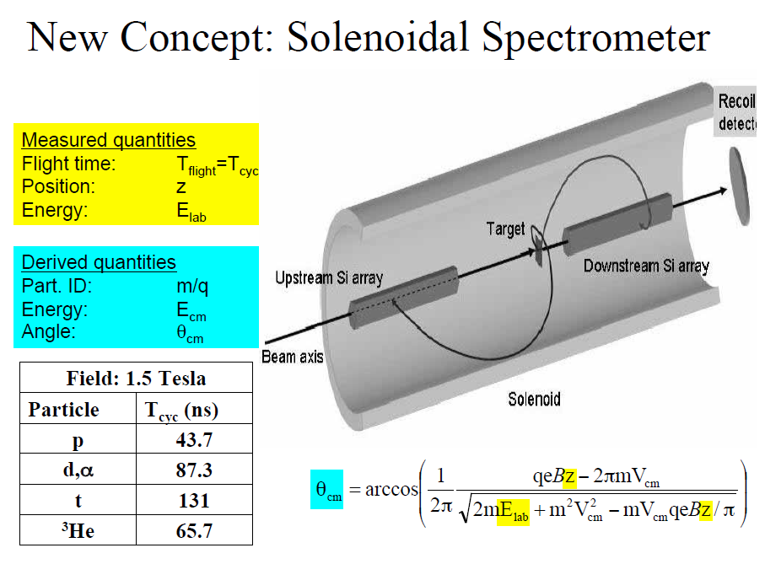
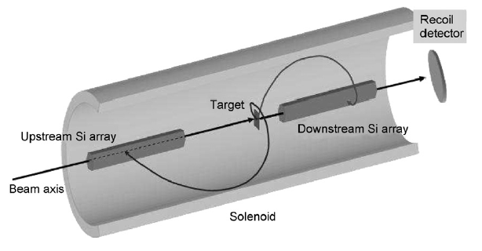
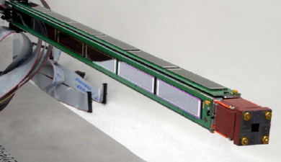
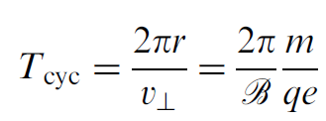
Transfer reactions with HELIOS – single-particle neutron energies outside of ¹³⁶Xe
Adapted from A. Wuosmaa
A. H. Wuosmaa et al., NIM A 580, 1290 (2007)
Figure from M. Huyse

Slide 14
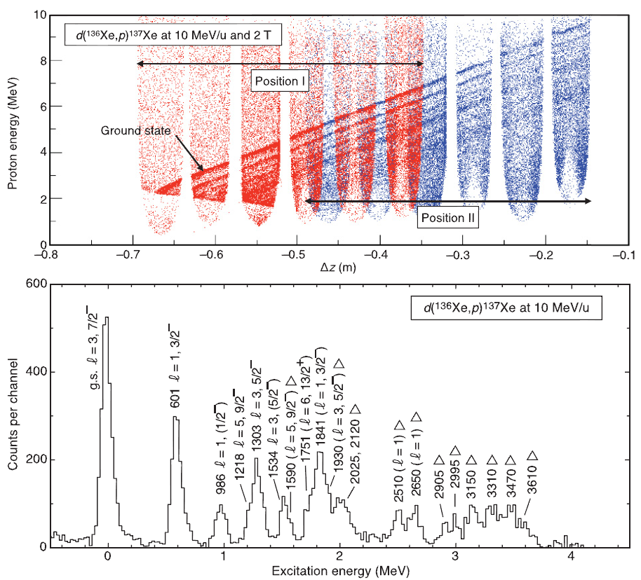
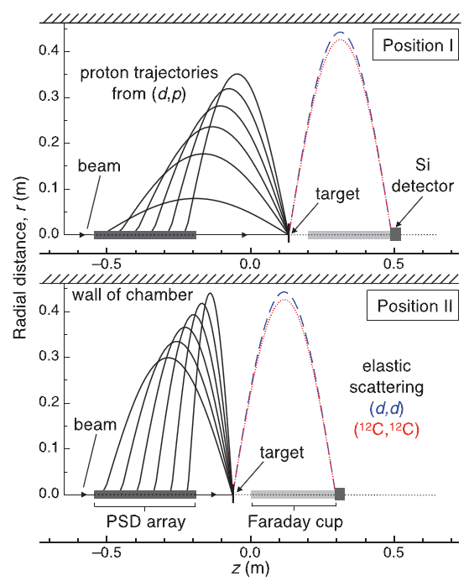
Transfer reactions with HELIOS – single-particle neutron energies outside of ¹³⁶Xe
B. P. Kay et al., PRC 84, 024325 (2011)
Figure from M. Huyse

Slide 15
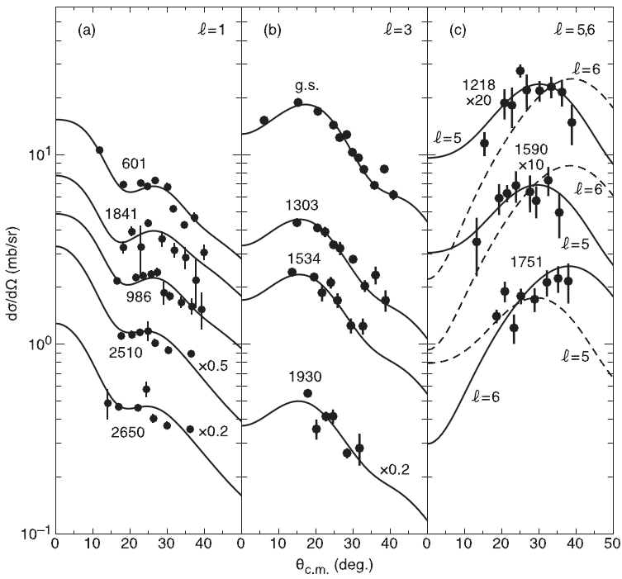
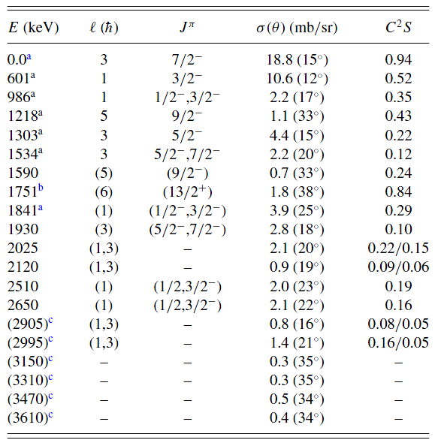
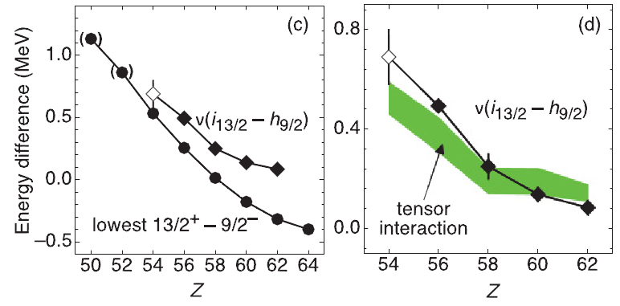
Transfer reactions with HELIOS – single-neutron energies outside of ¹³⁶Xe
The evolution of the neutron i_{13/2} and h_{9/2} as protons fill g_{7/2}
Figure from M. Huyse
B. P. Kay et al., PRC 84, 024325 (2011)

Slide 16
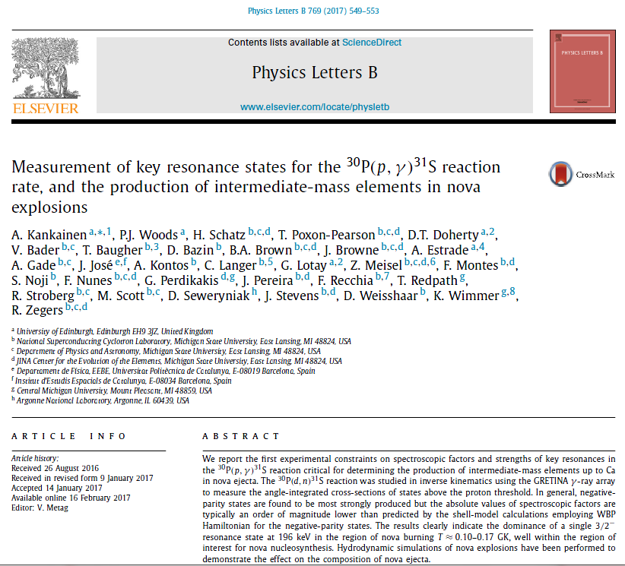
Transfer reactions as indirect probe to characterize capture reactions for astrophysics
Figure from M. Huyse

Slide 17
Transfer reactions as indirect probe to characterize capture reactions for astrophysics
Lack of knowledge of the rate of proton capture on radioactive ³⁰P is the most prominent nuclear physics uncertainty in models of oxygen neon (ONe) nova explosions
A direct measurement of the ³⁰P(p,γ)³¹S reaction is not currently feasible owing to the low available intensities of radioactive ³⁰P ion beams at the energies of astrophysical interest.
The ³⁰P(p,γ)³¹S reaction is critical for determining the production of intermediate-mass elements up to Ca in nova ejecta
Strategy: Use a novel technique to extract constraints on proton spectroscopic factors from measurements of angle-integrated cross sections for the ³⁰P(d,n)³¹S proton-transfer reaction in inverse kinematics using a radioactive ³⁰P beam → the resonance strength depends on the proton width and so on the proton spectroscopic factor
Figure from M. Huyse

Slide 18
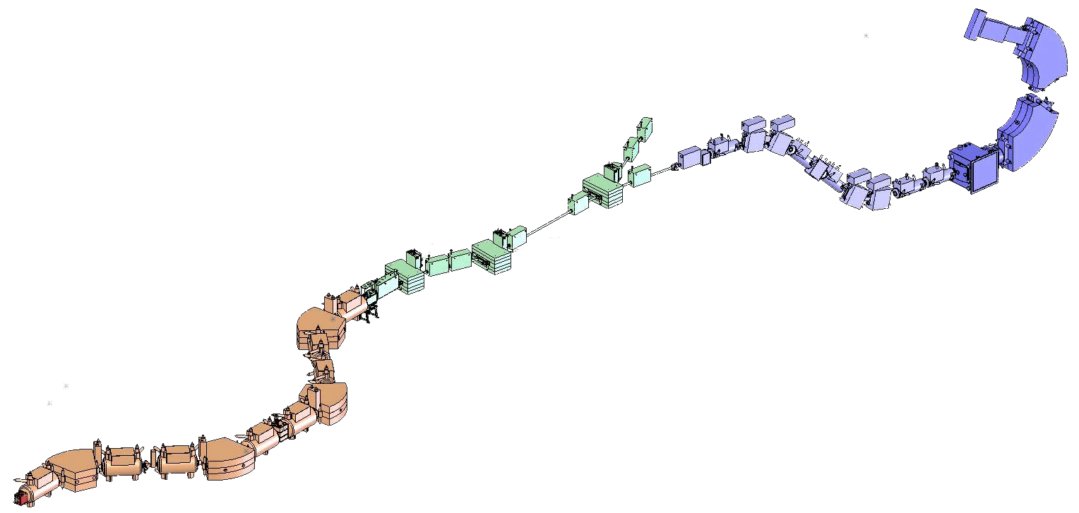
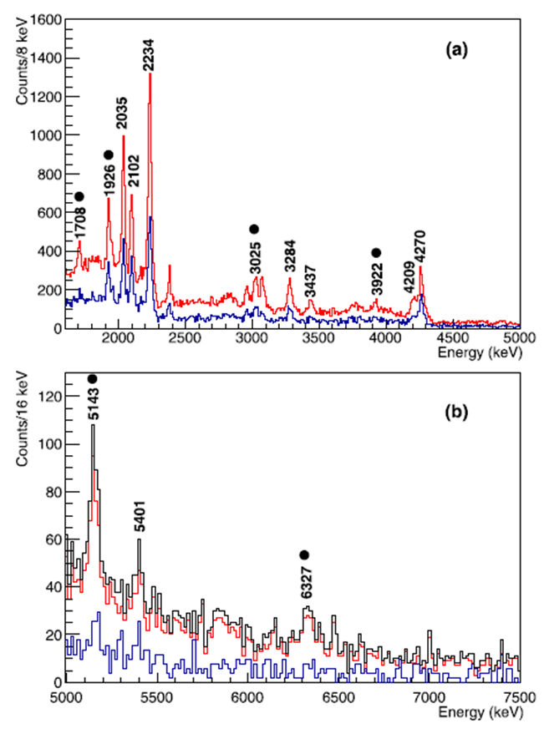
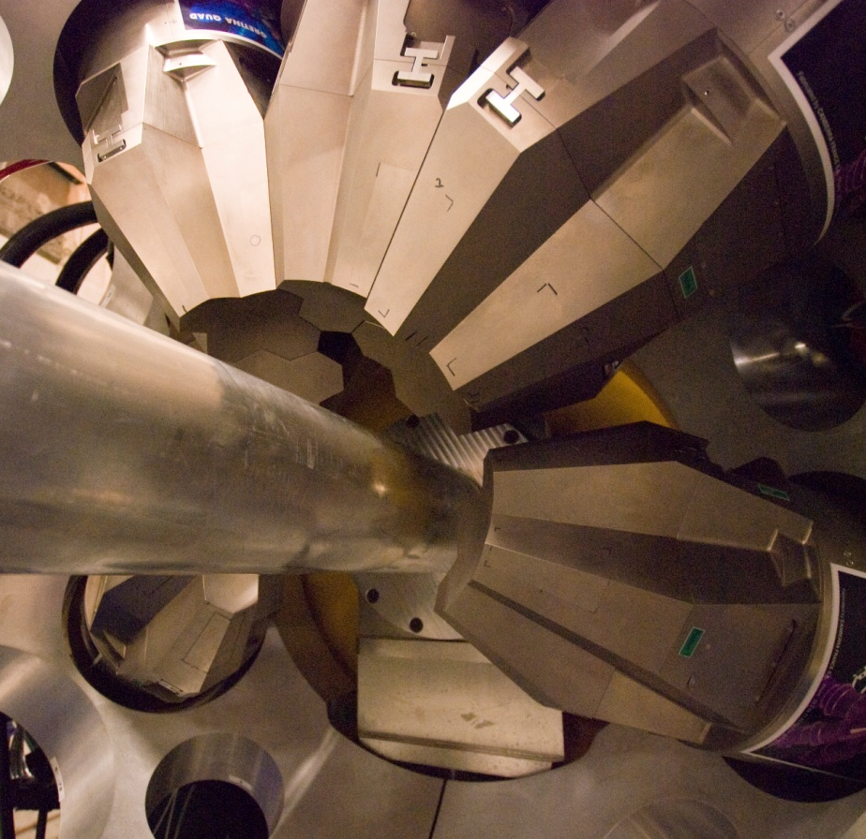

Transfer reactions as indirect probe to characterize capture reactions for astrophysics
³¹S identified in the focal plane of the S800 spectrograph – neutron is NOT detected (no angular distributions!). γ-ray spectroscopy identifies the final state with unmatched resolution
d(³⁰P,³¹S+γ)n reaction at 30 MeV/u
CD₂ target surrounded by GRETINA
³⁰P produced by projectile fragmentation of ³⁶Ar and separated in flight
A. Kankainen et al., PLB 84, 549 (2017)

Slide 19
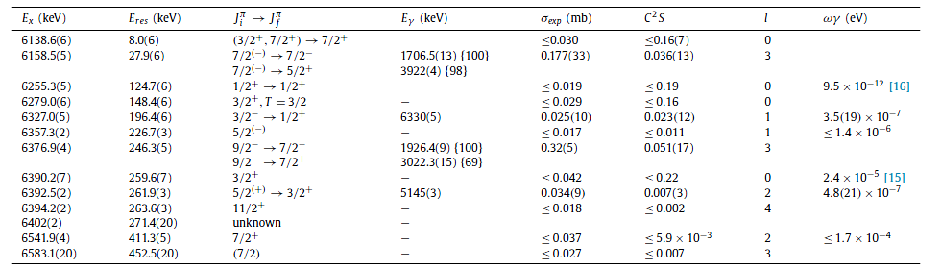
Transfer reactions as indirect probe to characterize capture reactions for astrophysics
Is impacted by spectroscopic factor
The results indicate the dominance of a single 3/2⁻ resonance at 196 keV in the region of nova burning. The nova explosion simulations show that the main effect of the present results on the composition of nova ejecta is an increase in the abundance of ³⁰Si critical for determining the ³⁰Si/²⁸Si ratio.
Figure from M. Huyse
A. Kankainen et al., PLB 84, 549 (2017)

Slide 20
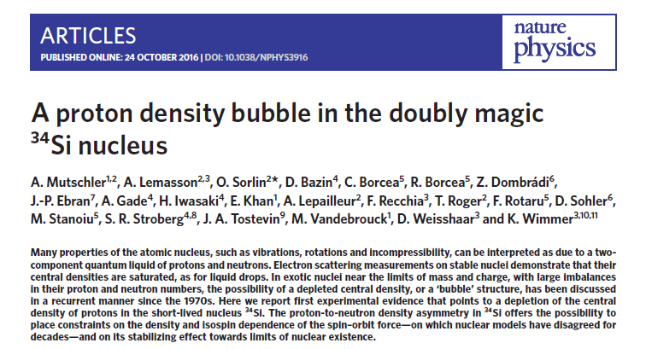
From occupancies to densities
A. Mutschler et al., Nature Physics 13, 152 (2017)

Slide 21
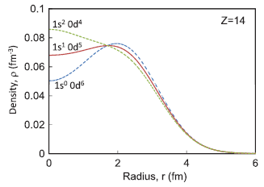
From occupancies to densities
The existence of so-called bubble nuclei had been predicted for decades – bubble here means a central density depletion of on nucleon species
³⁴Si is had been predicted to have a central depletion in the proton density with the origin of having the proton s_{1/2} orbital that is part of the sd shell essentially unoccupied
Strategy: measure the s_{1/2} occupancy with one-nucleon knockout ⁹Be(³⁴Si,³³Al+γ)X

Slide 22
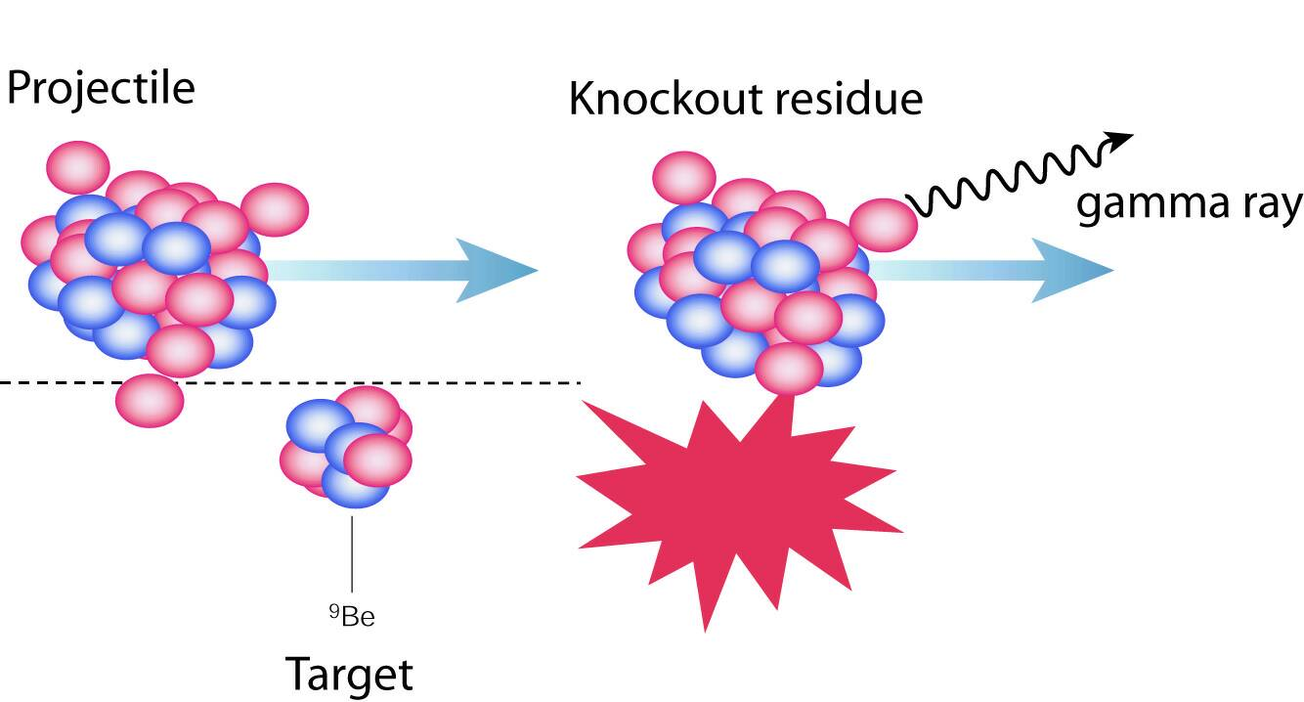
One-nucleon knockout
More than 50MeV/nucleon:
sudden approximation + eikonal approach (J.A. Tostevin, Surrey)
Spectroscopic Factors
determined from the population of the residue with A-1
d
p
s
=2
=0
residue moment distribution
→ -value of knocked-out n
P ||
spectroscopic factor
single-particle cross section
σ
π
=
∑
2
π
σ
(
nI
)
C
S
(
j
,
n
I
)
(
j
,
S
)
sp
N
P.G. Hansen and J. A. Tostevin, Annu. Rev. Nucl. Sci. 53, 219 (2003)
j
nuclear structure
reaction process
σ
(
j
,
S
)
=
σ
strip
(
j
+
σ
diffr
,
S
)
(
j
,
S
)
sp
n
sp
N
sp
N

Slide 23
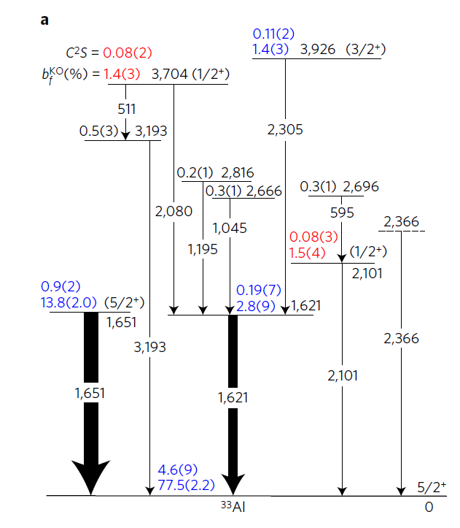
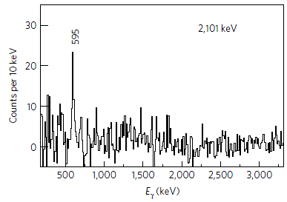
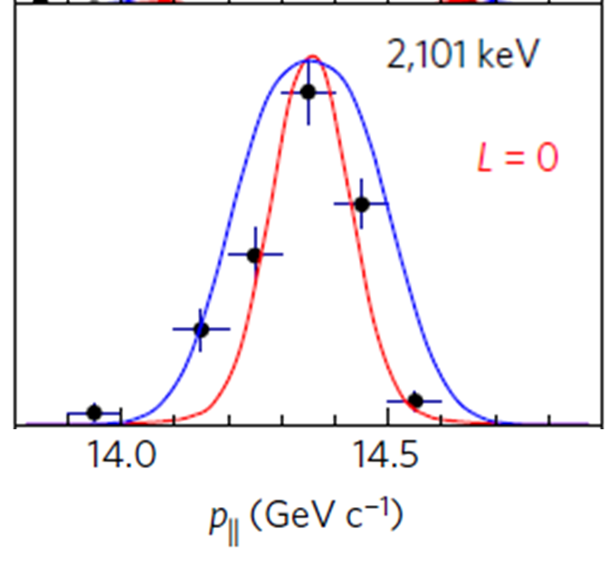
Analysis of one-nucleon knockout
Build the level scheme and determine partial cross section for the population of the 1/2⁺ state → reaction theory: orbital occupancy
A. Mutschler et al., Nature Physics 13, 152 (2017)

Slide 24
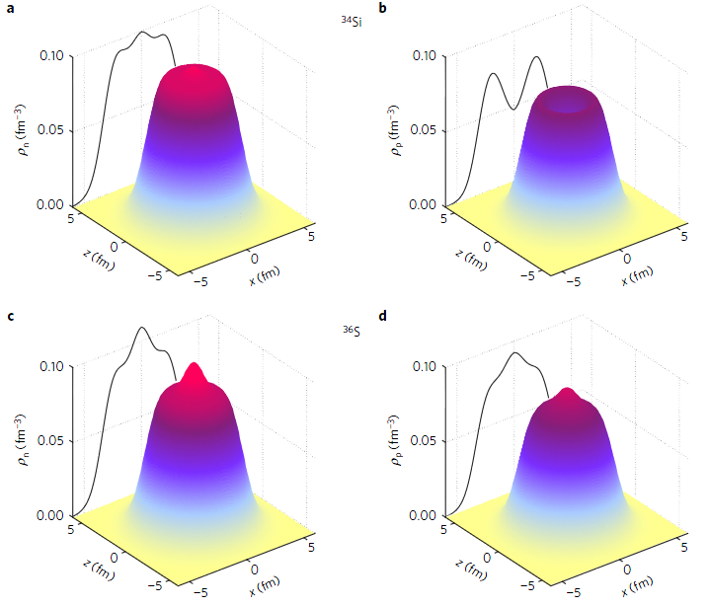
A depleted proton s_{1/2} orbital in ³⁴Si
³⁴Si
A depleted low-ℓ orbital will lead to a central dip in the density distribution (known to be a ~10% effect between ²⁰⁶Pb and ²⁰⁵Tl)
For ³⁴Si, a depleted 2s_{1/2} orbit is predicted to be a 40% effect relative to ³⁶S
One-proton knockout measurements at NSCL with GRETINA revealed a proton 2s_{1/2} occupancy of 0.17(3) in ³⁴Si relative to 1.7(3) for ³⁶S
³⁶S was studied with the very same approach, using the same reaction theory – important!
The neutrons don’t show a depletion: ³⁴Si 2s_{1/2} neutron occupancy is 2.0(3)
³⁶S
A. Mutschler et al., Nature Physics 13, 152 (2017)

Slide 25
Experimental considerations
Transfer reactions with light charged-particle detection in Si arrays: Require thin targets and intensities typically exceeding 10,000 projectiles/s. ¹³²Sn(d,p)¹³³Sn energy resolution: ~400 keV
Can be combined with γ-ray detection for unmatched resolution (needs even more beam or thicker targets …)
HELIOS spectrometer – superior energy resolution with ~100 keV but also requires thin targets and therefore comparably high beam intensities
γ-ray tagged transfer reactions at several 10 MeV/u: light-ion-induced or heavy-ion (HI) induced transfer reactions can be performed with thick targets and therefore high luminosities – however, typically no access to angular distributions but some ℓ information through momentum (mis)matching. Reaction theory for HI-induced reactions is rather messy
γ-ray tagged one-nucleon knockout reactions at >70 MeV/u projectile energy can have very thick targets and are possible at rates of 1 pps – however, only hole states can be accessed (and bound final states)

Slide 26
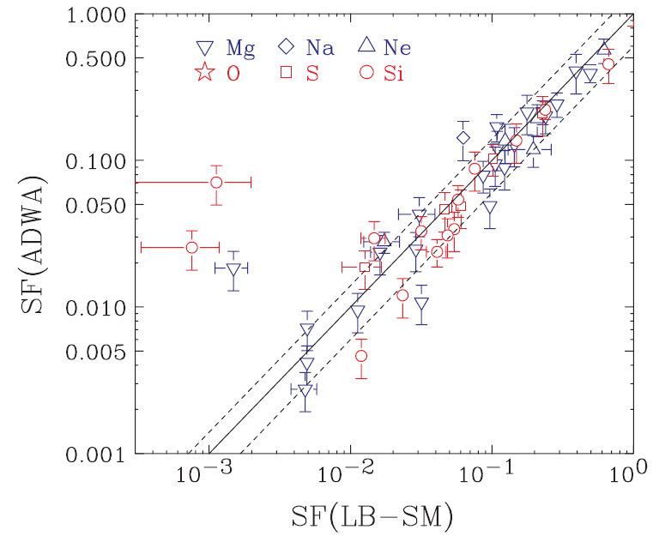
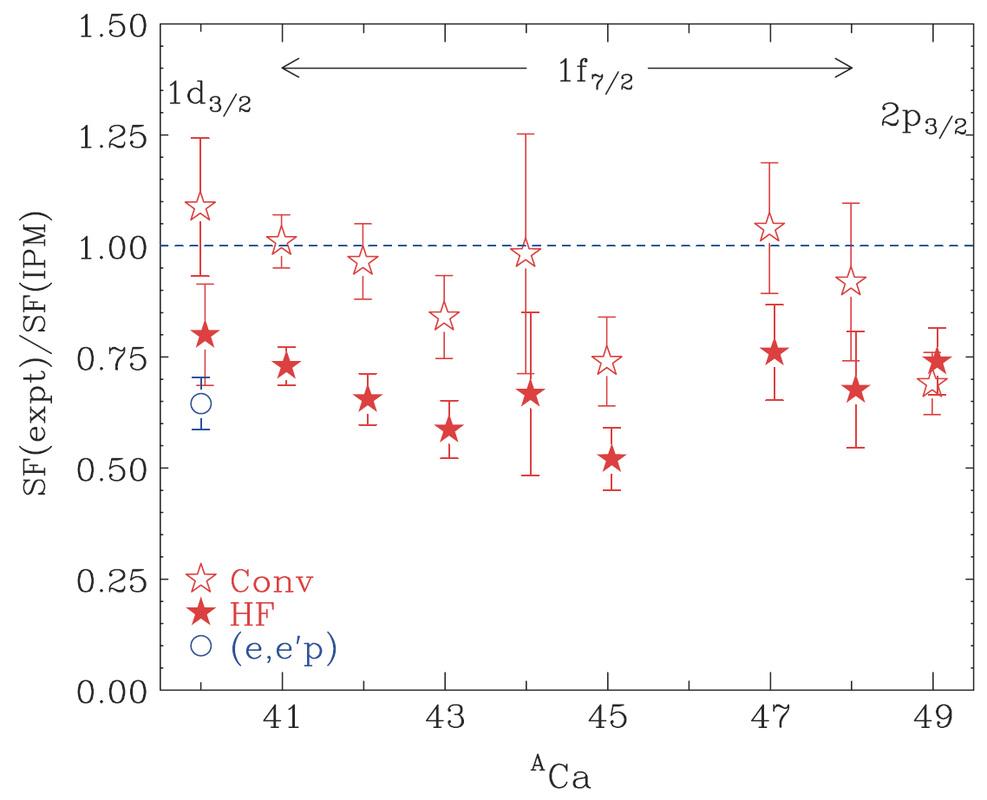
Issues, just one: model dependence spatial extent
Conventional: Traditional, fixed bound-state geometry a=0.65 fm and r₀=1.25fm gives the naïve IPM value
HF: SFs deduced with the bound-state geometry constrained as well as possible with the result of mean field calculations (SkX Skyrme) agree with the magnitude in reduction observed in (e,e,’p)
Three years later, back to standard parameters ... M. B. Tsang, Jenny Lee et al., PRL 102, 062501 (2009)
CH89 global potential, a=0.65, r₀=1.25fm
JLM folding potential, densities from SkX HF a=0.65, r₀ adjusted to fit HF orbital radius
J. Lee et al., PRC 73, 044608 (2006)

Slide 27
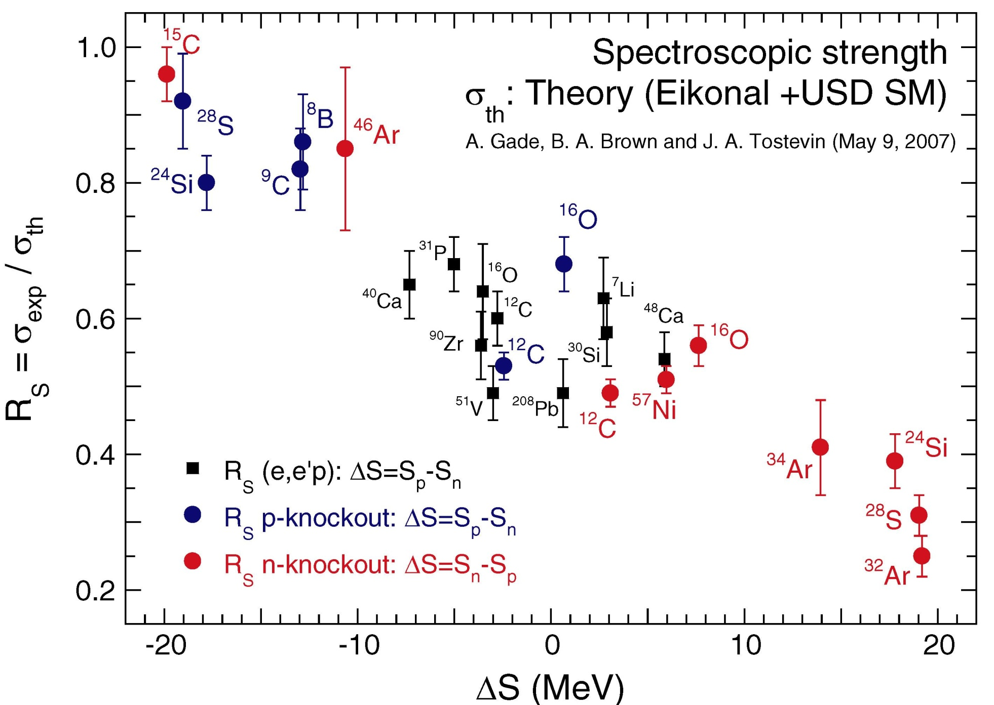
Knockout? Is tricky, too … Reduction close to stability
Shell M
A. Gade et al., PRC 77, 044306 (2008)

Slide 28
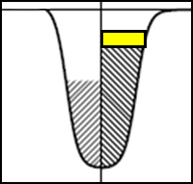
Knockout? Is tricky, too … Weakly-bound systems
Shell M
A. Gade et al., PRC 77, 044306 (2008)

Slide 29
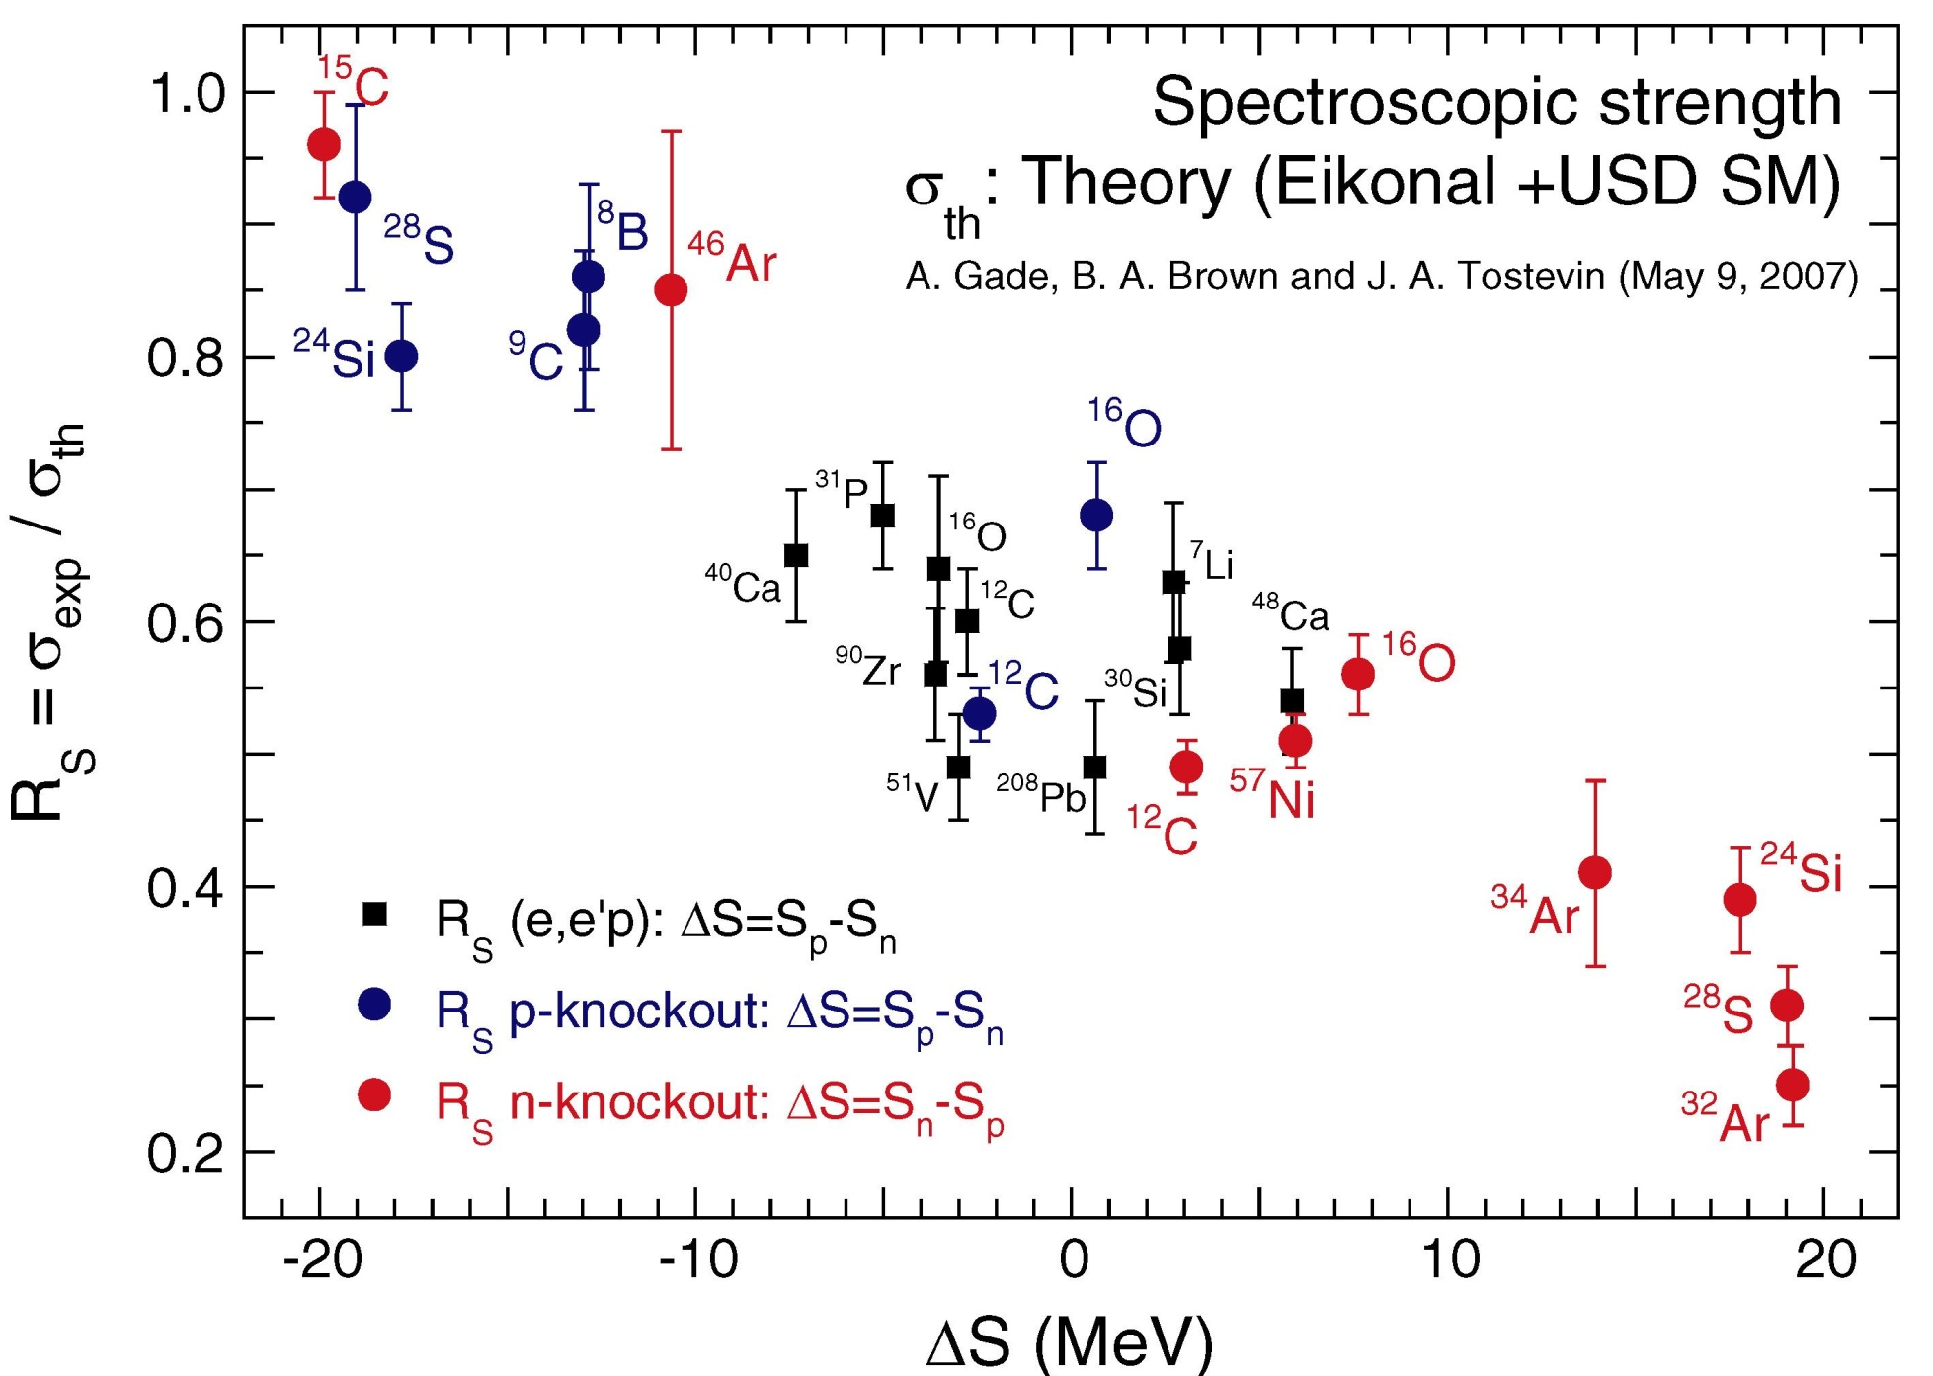
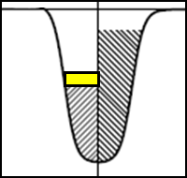
Knockout? Is tricky, too … Strongly-bound systems
Shell M
A. Gade et al., PRC 77, 044306 (2008)

Slide 30
So what to do?
Relative spectroscopic factors within one nucleus are very useful (but carefully evaluate l-dependent model sensitivities)
Model dependence roughly the same for neighboring nuclei → Can compare spectroscopic factors in a region when deduced with the same approach and within a consistent theoretical framework
With a lot of careful work and reaction dynamics comparisons, consistency may be accomplished across different techniques, e.g. knockout and (d,³He)
Best approach but has not been done for rare isotopes: Perform nucleon-adding and nucleon-removing reactions for the same nucleus within the same reaction dynamics framework and use the Macfarlane French sum rule: Deduce occupancies (from nucleon removal reactions) and vacancies (from nucleon adding transfer reactions), and normalize experimental spectroscopic factors with (2j+1) = vac + occ for a given orbital
A. Mutschler et al., Phys. Rev. C 93, 034333 (2016)
J. P. Schiffer et al., PRL 76, 022501 (2012)

Slide 31
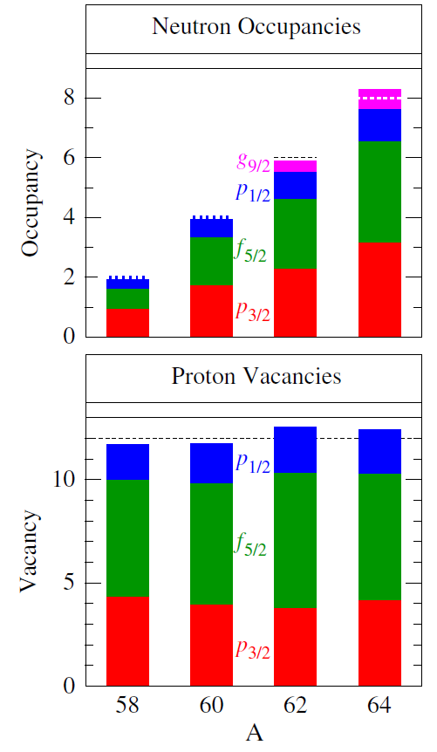
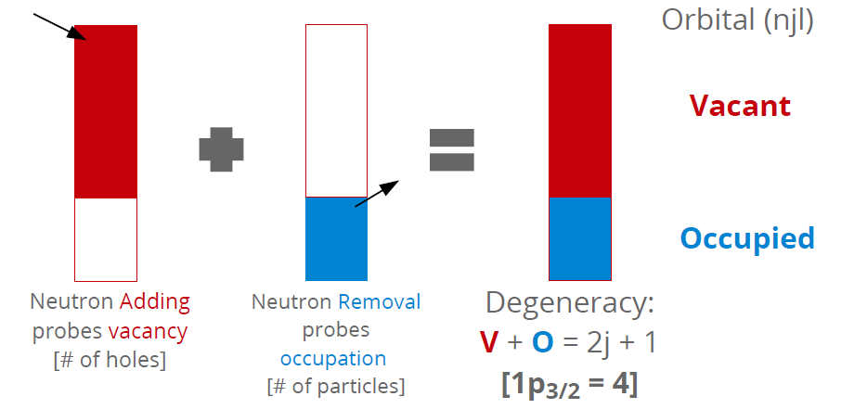
Measuring the sum rule
Here: outcome for ^{58,60,62,64}Ni
Adapted from C. Hoffman
J. P. Schiffer et al., PRL 76, 022501 (2012)

Slide 32
Related review articles
M. H. Macfarlane and J. B. French, Stripping Reactions and the Structure of Light and Intermediate Nuclei, Rev. Mod. Phys. 32, 567 (1960)
P. G. Hansen and J.A. Tostevin: Direct Reactions With Exotic Nuclei, Annu. Rev. Nucl. Part. Sci. 53, 219 (2003)
W. N. Catford, What Can We Learn from Transfer, and How Is Best to Do It?, Lecture Notes in Physics 879, 67 (2014)
D. W. Bardayan, Transfer reactions in nuclear astrophysics, J. Phys. G 43, 043001 (2016)

Slide 33
Appendix for the interested

Slide 34
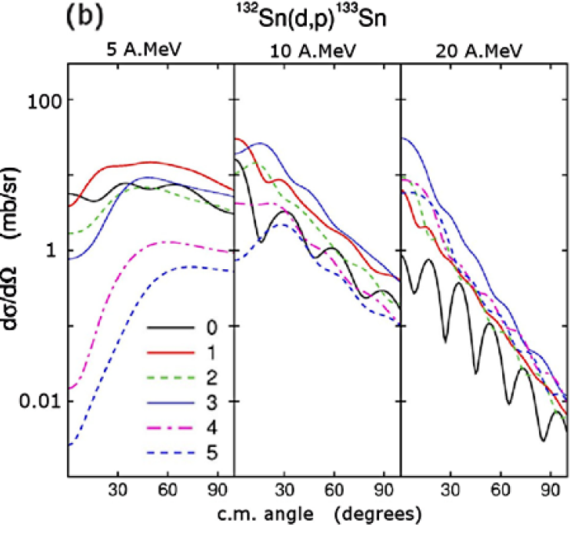
Digression: Playing with selectivity … beam energy and heavy ions as targets
Higher beam energy favors high-l transfer (momentum matching) but distinctiveness of angular distributions is lost along the way (also be careful where the c.m. angles transform to in the lab)
Other way to increase the cross section for high orbital angular momentum: Transfer deeply-bound nucleons out of heavy-ion targets, e.g. C, O
Figure from M. Huyse
W. N. Catford, Lecture Notes in Physics 879, 67 (2014)

Slide 35
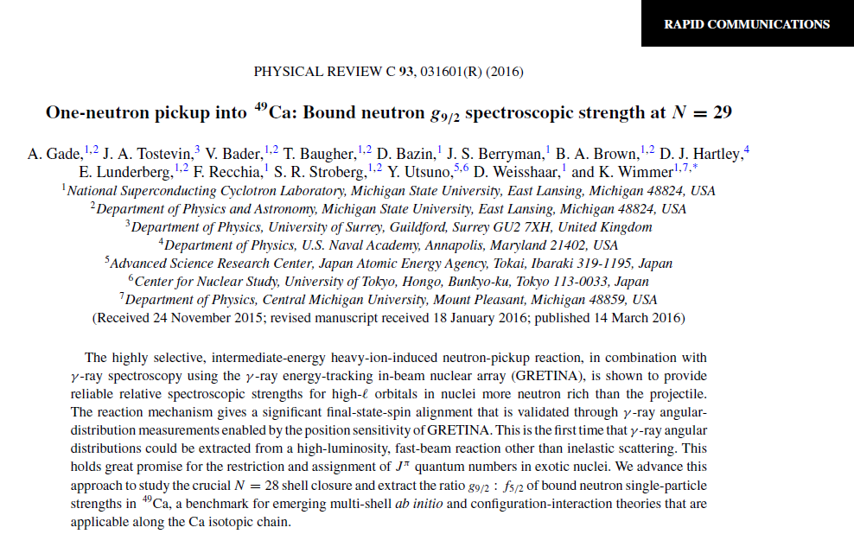
¹²C-induced transfer at 60 MeV/u
Figure from M. Huyse

Slide 36
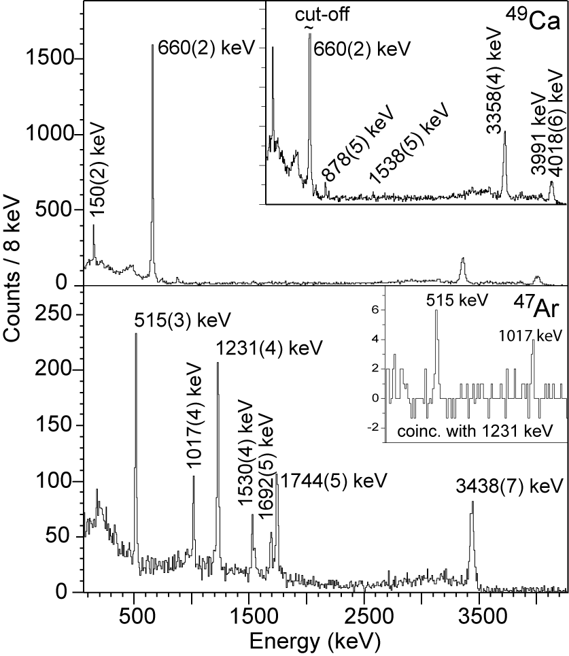
Exploiting the selectivity of transfer reactions
¹²C(⁴⁸Ca,⁴⁹Ca+γ)X and ¹²C(⁴⁶Ar,⁴⁷Ar+γ) reaction at >60 MeV/u
⁴⁹Ca or ⁴⁷Ar identified in the focal plane of the S800 spectrograph. γ-ray spectroscopy identifies the final state with unmatched energy resolution
¹²C target surrounded by GRETINA
Figure from M. Huyse
A. Gade et al., Phys. Rev. C 93, 054315 (2016)

Slide 37
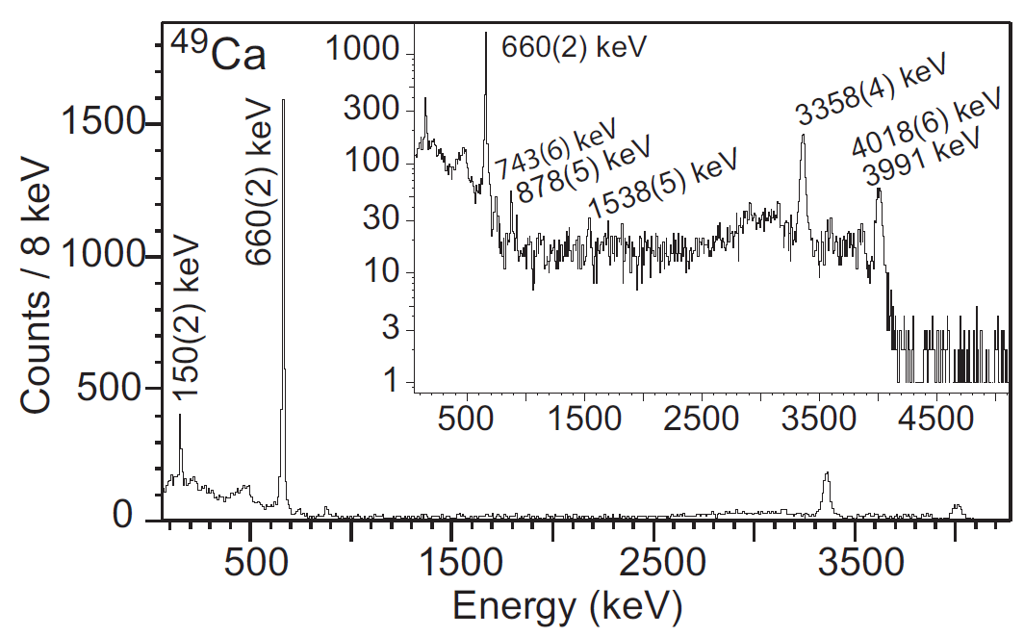
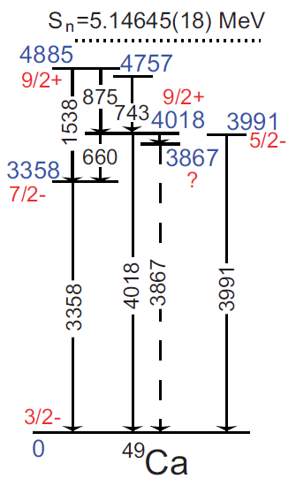
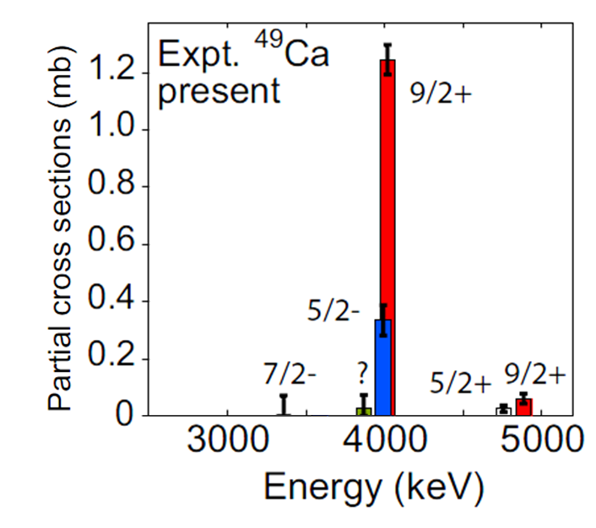
Fast-beam γ-ray one-neutron pickup reactions – neutron g_{9/2} spectroscopic strength in ⁴⁹Ca
Clean spectra through high-ℓ selectivity – only ℓ=3 and ℓ=4 states are populated (60 MeV/u)
Fast-beam γ-ray tagging and thick C targets allow for measurements at a few 1000 projectiles/s
One-neutron pickup from ⁴⁸Ca to ⁴⁹Ca provides a sensitive benchmark for shell model and identifies g_{9/2} strength that now can be included in the largest-scale calculations
A. Gade et al., PRC 93, 031601(R) (2016)

